Slide 1

List Based Scheduling
Masrur Jamil Prochchhod

Slide 2
MOTIVATION

Slide 3
List scheduling
Dynamic Prioritization
Resource Allocation
Dependency Management
Increase throughput

Slide 4
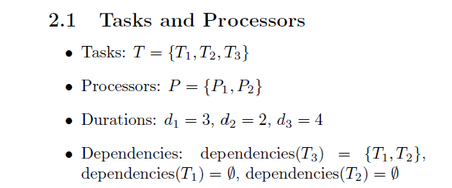
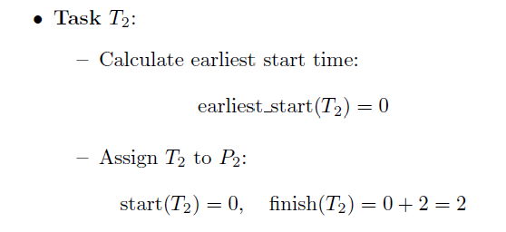
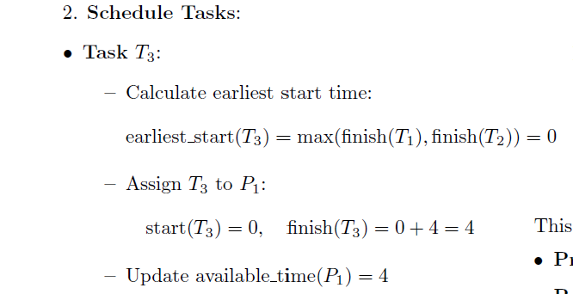
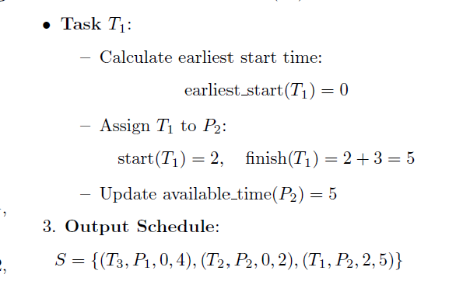
Working Procedure

Slide 5
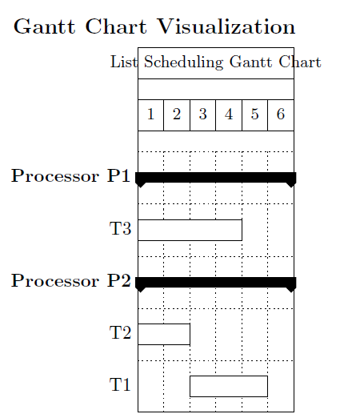
Gantt chart

Slide 6
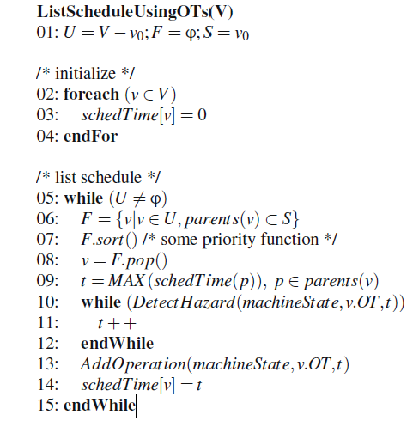
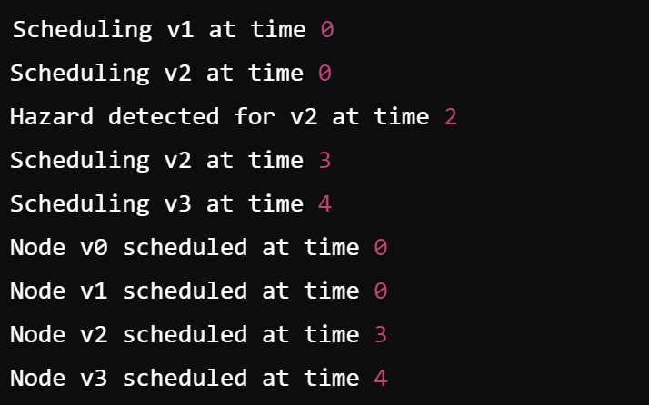
List Scheduling using OT
Fig:02 Result after Implementation
Fig:01 List Scheduling using OT [1]

Slide 7
Parallel computing innovations
Distributed Computing
innovations
Advance Load Balancing
Optimized Task Scheduling
Scalability Enhancements
Resource Management
Enhance Error Tolerance
Energy Efficient Scheduling

Slide 8
Emperical Assessments
Experimental Setup
Data Collection
Performance Evaluation
Comparative Analysis

Slide 9
Practical Applications
Real Time Systems
Cloud Computing
Parallel Systems

Slide 10
Pros and cons
Advantages
Disadvantages
Simplicity
Efficiency
Flexibility
Real Time Applications
Dependency Management
Overhead
Resource Conficts
Scalability Limitations
Adaptability

Slide 11
Conclusion
Effective Task Management
Versatility
Future Prospects
Overall Impact

Slide 12
Thank You

Slide 13
References
J ̈urgen Teich. Handbook of Hardware/Software Codesign. Springer, 2016. Code taken from page 822
Dror G Feitelson. Experimental analysis of the root causes of overheads in parallel job schedulers. ACM Transactions on Parallel Computing,5(1):1–26, 2018.
Michael J Flynn. Some computer organizations and their effectiveness. IEEE Transactions on Computers, C-21(9):948–960, 1972

